Slide 1

Web Scraping Project
Qifan wang

Slide 2
My Questions
Does the Color have effect on the Resale Price
Regressions to Appraisal Pre-owned Automobile Price
Which Brand Holds the Best Resale Value

Slide 3
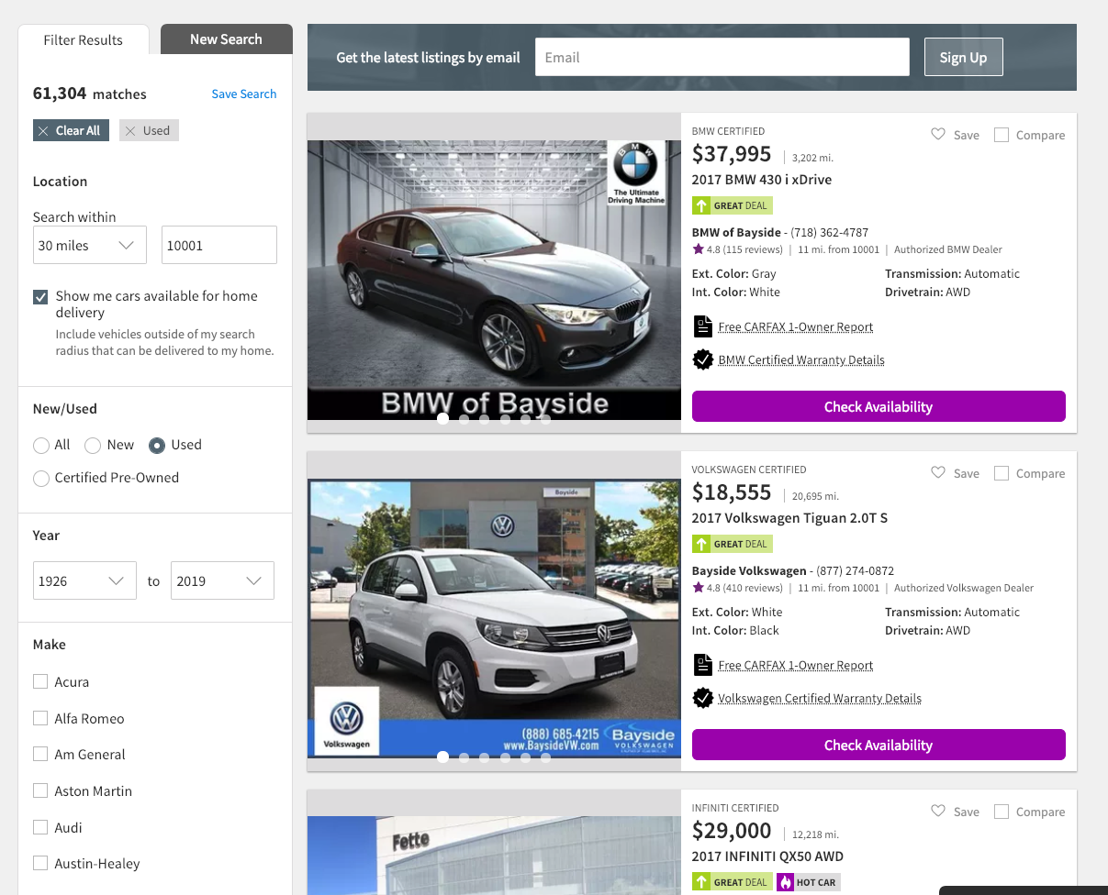
Web Scraping
Scrap Total Matches
/100 items Per Page
3. Scrap The URLS
Get The Make List

Slide 4
Sample Sizes
Total Sample Size: 56,859
Top 10: 37,958

Slide 5
Age vs Mileage

Slide 6
Age vs Price vs Make

Slide 7
Mileage vs Price vs Make

Slide 8

Multiple Linear Regression
Value = $β_{0}+β_{1}age+{(β}_{2}{age}^{2})+β_{3}mileage+[β_{4}x_{4}…+β_{i}x_{i}]$

Slide 9
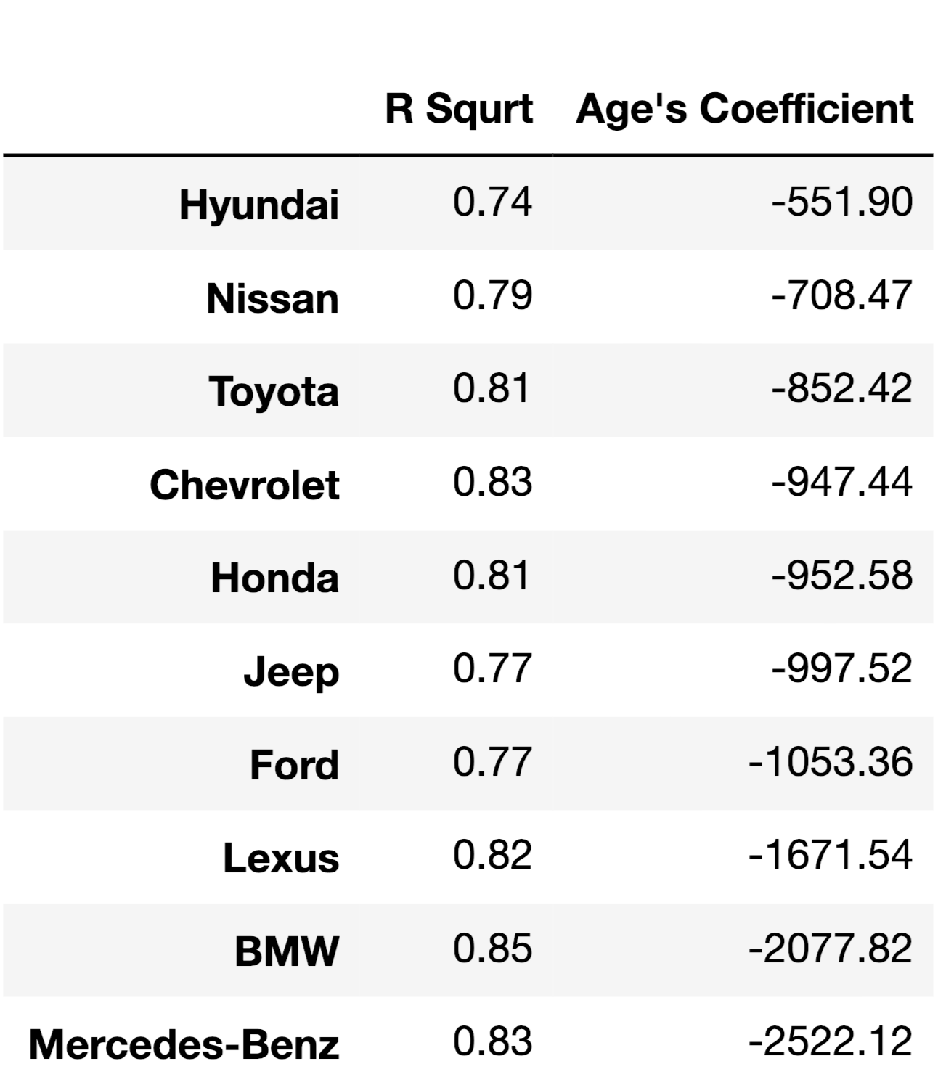
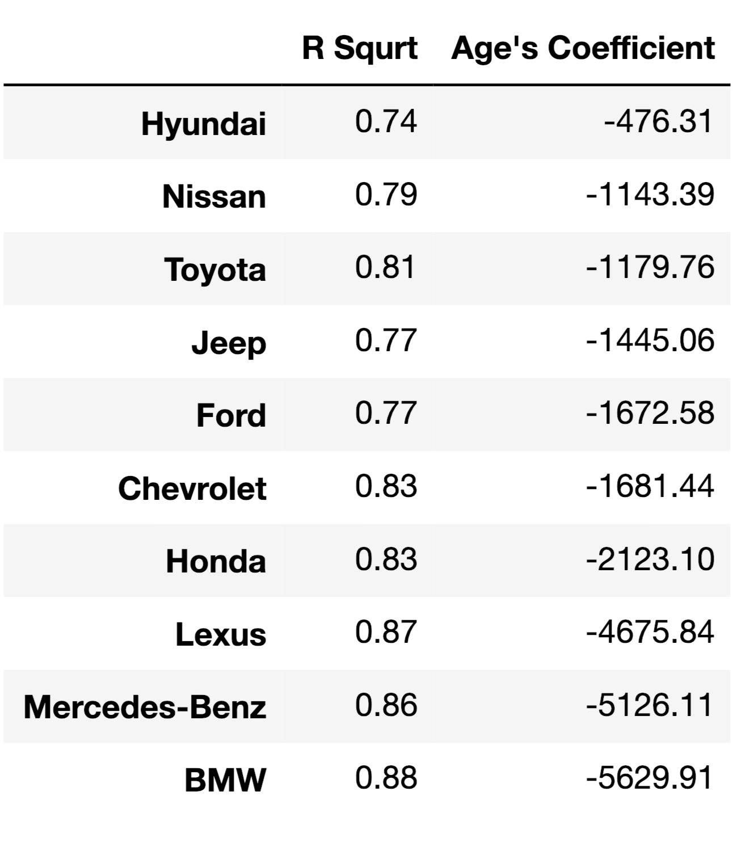

Result: $Age$ vs ${Age}^{2}$

Slide 10
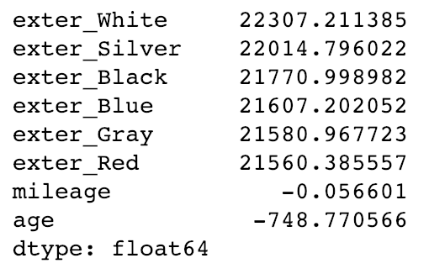
Questions
Which brand Holds the Best Resale Value
Does the Color really affect the Value
Larger Sample Size
Accord Color Ranking

